Slide 1
Unit 3
WWW Technology:
HTML, DHTML, WML, XML

Slide 2
What is World Wide Web (WWW)
The World Wide Web (www, W3) is an information system of interlinked hypertext documents that are accessed via the Internet. It has also commonly become known simply as the Web.
Individual document pages on the World Wide Web are called web pages and are accessed with a software application running on the user's computer, commonly called a web browser.
Web pages may contain text, images, videos, and other multimedia components, as well as web navigation features consisting of hyperlinks

Slide 3
Hyper Text Markup Language (HTML)
Hypertext Markup Language, a standardized system for tagging text files to achieve font, color, graphic, and hyperlink effects on World Wide Web pages
Hyper Text Markup Language, commonly referred to as HTML, is the standard markup language used to create web pages.
It is written in the form of HTML elements consisting of tags enclosed in angle brackets (like <html>).
HTML tags most commonly come in pairs like <h1> and </h1>, although some tags represent empty elements and so are unpaired, for example <img>. The first tag in a pair is the start tag, and the second tag is the end tag
Web browsers can read HTML files and compose them into visible or audible web pages.
Browsers do not display the HTML tags and scripts, but use them to interpret the content of the page.
HTML describes the structure of a website semantically along with cues for presentation, making it a markup language, rather than a programming language.

Slide 4
HTML Document Structure
A HTML document consists of two major portions:
Head
Contains information about the document, like the title and “meta” data describing the contents.
Body
Contains the actual matter of the document.
Gets displayed within the browser window.

Slide 5
DHTML
Dynamic HTML, or DHTML, is an umbrella term for a collection of technologies used together to create interactive and animated web sites by using a combination of a static markup language (such as HTML), a client-side scripting language (such as JavaScript), a presentation definition language (such as CSS), and the Document Object Model
DHTML allows scripting languages to change variables in a web page's definition language, which in turn affects the look and function of otherwise "static" HTML page content, after the page has been fully loaded and during the viewing process.
Thus the dynamic characteristic of DHTML is the way it functions while a page is viewed, not in its ability to generate a unique page with each page load.

Slide 6
Structure of a DHTML web page
DHTML applications are made up of the following pieces:
One or more HTML pages.
Script code that handles the events generated from the HTML pages.
A run-time component that hosts the page in the Web browser or Web browser control.
A project DLL that contains your Script code and is accessed by the run-time component, generated automatically when you debug or compile.
There is a one-to-one relationship between the designers and the HTML pages in your project. For each page in your application, there is a page designer.

Slide 7
Document Object Model
DHTML is not a technology in and of itself; rather, it is the product of three related and complementary technologies: HTML, Cascading Style Sheets (CSS), and JavaScript.
To allow scripts and components to access features of HTML and CSS, the contents of the document are represented as objects in a programming model known as the Document Object Model (DOM).
The DOM API is the foundation of DHTML, providing a structured interface that allows access and manipulation of virtually anything in the document.
The HTML elements in the document are available as a hierarchical tree of individual objects, meaning you can examine and modify an element and its attributes by reading and setting properties and by calling methods.
The text between elements is also available through DOM properties and methods.
The DOM also provides access to user actions such as pressing a key and clicking the mouse.
You can intercept and process these and other events by creating event handler functions and routines.
The event handler receives control each time a given event occurs and can carry out any appropriate action, including using the DOM to change the document.

Slide 8
Dynamic Styles
Dynamic styles are a key feature of DHTML. By using CSS, we can quickly change the appearance and formatting of elements in a document without adding or removing elements.
This helps keep documents small and the scripts that manipulate the document fast.
The object model provides programmatic access to styles.
This means you can change inline styles on individual elements and change style rules using simple JavaScript programming.
Inline styles are CSS style assignments that have been applied to an element using the style attribute.
You can examine and set these styles by retrieving the style object for an individual element.
For example, to highlight the text in a heading when the user moves the mouse pointer over it, you can use the style object to enlarge the font and change its color,

Slide 9
Uses of DHTML
Animate text and images in their document, independently moving each element from any starting point to any ending point, following a predetermined path or one chosen by the user.
Embed a ticker that automatically refreshes its content with the latest news, stock quotes, or other data.
Use a form to capture user input, and then process, verify and respond to that data without having to send data back to the server.
Include rollover buttons or drop-down menus.

Slide 10
Advantage of DHTML
Lessened server load. DHTML applications conserve server resources because each request or user action does not have to be routed through the Web server.
Fewer refreshes, faster responses. When an end user's actions initiate changes to a typical Web page, the browser must refresh the page from the server. In a DHTML application, the browser can process user data, make changes to the page's layout and appearance, and process code all without refreshing the page.
Dynamic interaction. Scripting code on a Web page can directly manipulate any element on the page and create and manage new elements on the fly, allowing for truly dynamic user interfaces.

Slide 11
Contd ….
Improved state management. Typically, HTML pages are stateless that is, no information about an HTTP request is maintained after the response is received from the server. DHTML applications allow you to store state between requests, without using the server. Therefore, multiform or multipage applications are possible without requiring server interaction, complex URL-based state, or cookies.
Offline capability. For a DHTML application, users can browse to and use a DHTML application on their corporate intranet. Later, when disconnected, the same users can still make use of their Web-based application through the browser’s cached storage.
Code security. When you embed scripts within an HTML page, anyone can access your page, read the script, and make changes to it. Using Visual Basic to develop your DHTML application, your code is compiled, is not part of the HTML page itself, and cannot be tampered with as easily.

Slide 12
Wireless Markup Language (WML)
WML is a markup language designed especially for specifying and displaying content on WAP (Wireless Application Protocol) devices.
WML is part of the WAP application environment, which requires the use of WML.
WML is the wireless equivalent of HTML for the Web.
WML is based on XML and derived from xHTML (the XML version of HTML).
There are many differences between WML and HTML.
For example, WML has a different mechanism for linking between its pages called “cards” as compared to linking between HTML pages.
WML browsers are stricter than HTML browsers by not being tolerant of errors. WML browsers enforce the WML requirement of matching closing “tags”, an XML characteristic

Slide 13
Overview of WML
Motivation
Problems with Wireless Networks
Advances of mobile communication
systems, especially GSM
Phenomenal growth of handy, PDA and
other handheld devices
New services required
Low bandwidth
High latency and jitter
High transmission error rate
Low connection stability

Slide 14
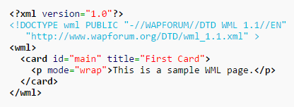
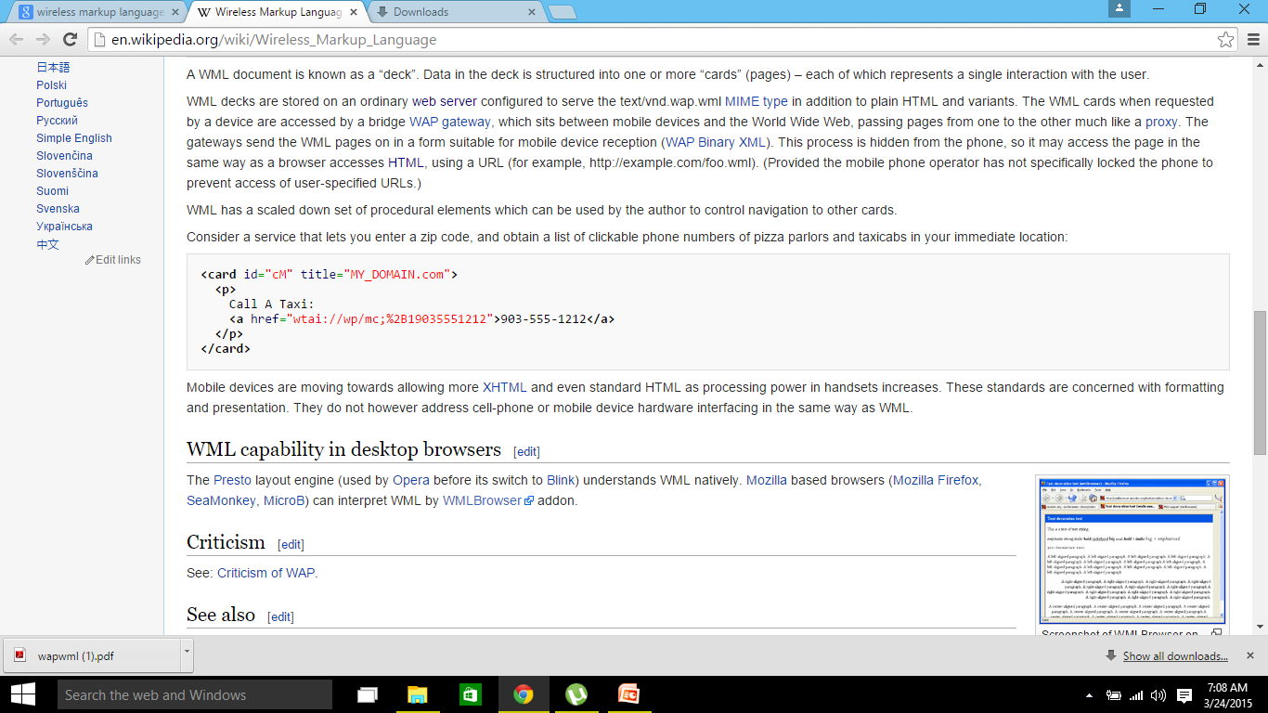
WML Structure

Slide 15
Description
WML documents are XML documents that validate against the WML DTD (Document Type Definition).
The W3C Markup Validation service (http://validator.w3.org/) can be used to validate WML documents (they are validated against their declared document type).
A WML document is known as a “deck”. Data in the deck is structured into one or more “cards” (pages) – each of which represents a single interaction with the user.
WML decks are stored on an ordinary web server configured to serve the text/vnd.wap.wml MIME type in addition to plain HTML and variants.
The WML cards when requested by a device are accessed by a bridge WAP gateway, which sits between mobile devices and the World Wide Web, passing pages from one to the other much like a proxy.
The gateways send the WML pages on in a form suitable for mobile device reception (WAP Binary XML).
This process is hidden from the phone, so it may access the page in the same way as a browser accesses HTML, using a URL (for example, http:// example.com/foo.wml). (Provided the mobile phone operator has not specifically locked the phone to prevent access of user-specified URLs.)

Slide 16
Working of WML
The user selects an option on their mobile device that has a URL with Wireless Markup language (WML) content assigned to it.
The phone sends the URL request via the phone network to a WAP gateway, using the binary encoded WAP protocol.
The gateway translates this WAP request into a conventional HTTP request for the specified URL, and sends it on to the Internet.
The appropriate Web server picks up the HTTP request.
The server processes the request, just as it would any other request. If the URL refers to a static WML file, the server delivers it. If a CGI script is requested, it is processed and the content returned as usual.
The Web server adds the HTTP header to the WML content and returns it to the gateway.
The WAP gateway compiles the WML into binary form. viii. The gateway then sends the WML response back to the phone.
He phone receives the WML via the WAP protocol.
The micro--‐browser processes the WML and displays the content on the screen.

Slide 17
Contd..
Problems with Wireless Terminals
Solutions
Small screen, limited display capability
One-finger navigation
Limited RAM/ROM
Limited CPU performance
Low battery life
Internet access via handheld devices was possible before WAP, but the technologies never took off commercially because they used proprietary technologies that didn‘t work across different platforms

Slide 18
Advantages of WML
WML is part of the WAP standard and its use is required.
Transmission of WML (WMLC) documents requires less bandwidth compared to HTML documents because WML documents are simpler and WML is compressed before it is sent to the WAP device.
Compared to HTML documents, displaying WML documents requires less processing power and memory. Consequently, a WAP device can work with a less powerful (cheaper) CPU and the use of less power means that the battery can operate longer without recharging.
WML provides support for limited graphics with a limited gray scale

Slide 19
Limitations of WML
Like HTML, WML does specify how the content is to be displayed. Thus micro browsers on different WAP devices are likely to display the WML content differently.
WAP devices such as WAP phones will not accept large decks (1.4K for some WAP phones).
There are many variations between WAP phones, for example Screen sizes, keypads, and soft keys can be different.
Consequently, WML decks should be tested on at least the important WAP devices.
This variation is similar to the variation found with Web browsers and their platforms.
The problem is harder in case of WML because there are many more WAP devices than Web browsers and their platforms.
It is harder to figure out the “least common denominator”, i.e., set of features that will work reasonably well on all or most WAP devices.

Slide 20
Possible Applications
M-commerce - shopping, tickets, micro-payments
Finance - statements, funds transfer, shares trading
M-billing - notification, presentation and payment of bills
Enterprise access - inventory, shipment/sales updates, email
M-care - customer service, payment status, account updates
Entertainment - games, gambling, interactive multi-player Events
Messaging - communication and collaboration
Travel - scheduling, advisories, reservations
Location services - traffic reports, parking information, store discounts, event recommendations

Slide 21
WAP 2.0 - the Next Generation
XHTML (with backwards compatibility to WML)
TCP
Color graphics
Animation
Large file downloading
Location-smart services
Streaming media
Data synchronization with desktop PIM

Slide 22
Extensible Markup Language (XML)
Extensible Markup Language (XML) is a markup language that defines a set of rules for encoding documents in a format which is both human-readable and machine-readable.
It is defined by the W3C's XML 1.0 Specification and by several other related specifications, all of which are free open standards.
The design goals of XML emphasize simplicity, generality and usability across the Internet. It is a textual data format with strong support via Unicode for different human languages.
Although the design of XML focuses on documents, it is widely used for the representation of arbitrary data structures such as those used in web services.
Several schema systems exist to aid in the definition of XML-based languages, while many application programming interfaces(APIs) have been developed to aid the processing of XML data

Slide 23
Comparisons
XML
HTML
Extensible set of tags
Content orientated
Standard Data infrastructure
Allows multiple output forms
Fixed set of tags
Presentation oriented
No data validation capabilities
Single presentation

Slide 24
Key terminology
(Unicode) character- By definition, an XML document is a string of characters. Almost every legal Unicode character may appear in an XML document.
Processor and application- The processor analyzes the markup and passes structured information to an application.
Markup and content- The characters making up an XML document are divided into markup and content, which may be distinguished by the application of simple syntactic rules.
Tag- A markup construct that begins with < and ends with >. Tags come in three flavors: start-tags; for example: <section> end-tags; for example: </section>
Element- A logical document component which either begins with a start-tag and ends with a matching end-tag or consists only of an empty-element tag. The characters between the start- and end-tags, if any, are the element's content, and may contain markup, including other elements, which are called child elements. An example of an element is<Greeting>Hello, world.</Greeting>. Another is <line-break />.
Attribute- A markup construct consisting of a name/value pair that exists within a start-tag or empty-element tag.
XML declaration -XML documents may begin by declaring some information about themselves, as in the following example: <?xml version="1.0" encoding="UTF-8"?>

Slide 25
Well- formed-ness and error-handling
The document contains only properly encoded legal Unicode characters
None of the special syntax characters such as < and & appear except when performing their markup-delineation roles
The begin, end, and empty-element tags that delimit the elements are correctly nested, with none missing and none overlapping
The element tags are case-sensitive; the beginning and end tags must match exactly.
Tag names cannot contain any of the characters !"#$%&‘()*+, /;<=>?@[\]^`{|}~, nor a space character, and cannot start with -, ., or a numeric digit.
A single "root" element contains all the other elements

Slide 26
Schemas and validation
In addition to being well-formed, an XML document may be valid. This means that it contains a reference to a Document Type Definition (DTD), and that its elements and attributes are declared in that DTD and follow the grammatical rules for them that the DTD specifies.
XML processors are classified as validating or non-validating depending on whether or not they check XML documents for validity.
A processor that discovers a validity error must be able to report it, but may continue normal processing.
A DTD is an example of a schema or grammar. Since the initial publication of XML 1.0, there has been substantial work in the area of schema languages for XML.
Such schema languages typically constrain the set of elements that may be used in a document, which attributes may be applied to them, the order in which they may appear, and the allowable parent/child relationships

Slide 27
Document Type Definition
DTDs have the following benefits:
DTD support is ubiquitous due to its inclusion in the XML 1.0 standard.
DTDs are terse compared to element-based schema languages and consequently present more information in a single screen.
DTDs allow the declaration of standard public entity sets for publishing characters.
DTDs define a document type rather than the types used by a namespace, thus grouping all constraints for a document in a single collection.
DTDs have the following limitations:
They have no explicit support for newer features of XML, most importantly namespaces.
They lack expressiveness. XML DTDs are simpler than SGML DTDs and there are certain structures that cannot be expressed with regular grammars. DTDs only support rudimentary data types.
They lack readability. DTD designers typically make heavy use of parameter entities (which behave essentially as textual macros), which make it easier to define complex grammars, but at the expense of clarity.
They use a syntax based on regular expression syntax, inherited from SGML, to describe the schema.

Slide 28
XML structure
<?xml version="1.0" encoding="UTF-8"?> <!DOCTYPE note SYSTEM "Note.dtd"> <note> <to>Tove</to> <from>Jani</from> <heading>Reminder</heading> <body>Don't forget me this weekend!</body> </note>
<!DOCTYPE note [ <!ELEMENT note (to,from,heading,body)> <!ELEMENT to (#PCDATA)> <!ELEMENT from (#PCDATA)> <!ELEMENT heading (#PCDATA)> <!ELEMENT body (#PCDATA)> ]>

Slide 29
Possible Advantages of Using XML
Truly Portable Data
Easily readable by human users
Very expressive (semantics near data)
Very flexible and customizable (no finite tag set)
Easy to use from programs (libs available)
Easy to convert into other representations (XML transformation languages)
Many additional standards and tools
Widely used and supported

